Slide 1





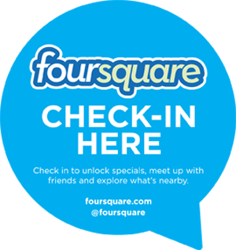


USER GENERATED CONTENT ANALYTICS Classification with Text + Sentiment Analysis September 19, 2017

Slide 2
Text Analytics: From Unstructured to Structured
Numeric data easier to deal with than unstructured
E.g., classification of loan default based on demographics and transaction data
But what about text?
Represent documents by some attributes (e.g., presence or absence of “terms”)
Then use existing data mining methods on attributes
Bag-of-words models
Add some statistical characteristics
E.g., term frequency, document frequency, length, etc.

Slide 3
Document Representation
Binary representation: Presence of absence of terms
 | Terms (vocabulary)
 | Digital | Camera | Memory | Pixel | ….
Doc 1 | 1 | 1 | 0 | 1
Doc 2 | 1 | 1 | 1 | 0
….
But a term can occur multiple times in a document
 | Terms
 | Digital | Camera | Memory | Pixel | ….
Doc 1 | 1 | 2 | 0 | 1
Doc 2 | 2 | 3 | 1 | 0
….

Slide 4
Using Relative Frequencies
Use # of occurrences of a term in a document / # terms in the document
 | Terms
 | Digital | Camera | Memory | Pixel | ….
Doc 1 | .01 | .02 | 0 | .01
Doc 2 | .002 | .003 | .001 | 0
….

Slide 5
Classification with Text
Text | Outcome (Class)
Senior position in corporate finance, 20+ years experience preferred | High salary
This restaurant was a waste of time & money. Everything sucks here! | Negative sentiment

Slide 6
But Not All Words Are Created Equal
The main idea (for classification):
Words (or more generally, terms) that appear frequently in a document are …
Words that appear frequently in most documents are ….
Need a metric that shows the importance of a term to a document in a corpus.
Term frequency-Inverse document frequency (TF-IDF) = Frequency of a term in a document * log (1/proportion of documents containing the term)

Slide 7
Sentiment Analysis
Why bother?
Challenges galore
Sarcasm detection
Multiple products & attributes mentioned in the same post.
“The lobby of the Skylark was cool, but the room was nothing to write home about; the food was good, but the location was too far away from transportation. In hindsight, although the Rising Sun was very pricey, its awesome location and high-end ambience would have been great.”
Two approaches: Supervised and unsupervised

Slide 8
Can Social Mentions Predict Box Office Hits?
Predictive power of social mentions for movies: http://www.youtube.com/watch?v=uHmn2qsgBsU
Top 10 Box Office Hits of 2012 (Hollywood)
Average # social mentions: 244,000
Change in mentions volume from pre -> post release: +70%
Opening day average volume: 23,000 in 24 hours
Average negative sentiment: 9% (of total mentions)
Pre- to post-release: Negatives stayed constant at ~ 9%
Top 10 Box Office Flops of 2012
Average # mentions: 45,000
Change in volume from pre -> post release: +17%
Opening day average volume: 4,000 in 24 hours
Average negative sentiment: 23%
Pre- to post-release: Negatives increased from 23% to 27%
Source: http://socialmediatoday.com/brendan-williams/1519036/two-thumbs-using-social-media-trends-anticipate-box-office-success

Slide 9
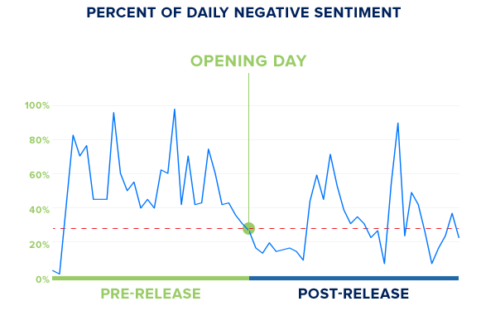
Negative Sentiment for “John Carter”
Threshold for hit/flop
(maximum negative
sentiments for a hit)
Source: http://socialmediatoday.com/brendan-williams/1519036/two-thumbs-using-social-media-trends-anticipate-box-office-success

Slide 10


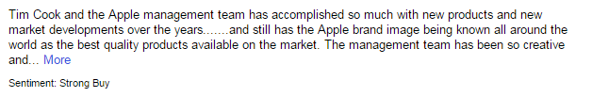
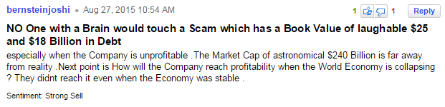
Incorporating Sentiments & Mentions in the Returns Model
Do message sentiments improve prediction?
Training data for stock sentiments
Sentiment index =
(total number of buy - total number of sell) / (total number of buy + total number of sell)
Log(number of new items + 1) about a stock

Slide 11
Predicting Stock Returns (the Trillion $ Question): Do Sentiments Matter?
Capital Asset Pricing Model (CAPM)
Fama-French factors
Return on an asset
r = R_{f} + β.(K_{m} – R_{f}) + b_{s}.SMB + b_{v}.HML + α
R_{f}: risk free rate, K_{m}: Return of market portfolio
SMB: Small (market cap) minus big
HML: High (book-to-mkt) minus low
Addition of momentum (Up minus Down) factor

Slide 12
Supervised Sentiment Analysis
Start with a collection of documents whose sentiments are known (i.e., they have been labeled manually)
Many approaches are possible – from the naïve to the sophisticated
Unigrams or “bag-of-words” for starters – single words, assumed to occur independently of each other in a document

Slide 13
Simplest Approach to Sentiment Analysis?
“It’s rather like a lifetime special – pleasant, sweet and forgettable.”
Positive reviews in
training data: 15 occurrences
Negative reviews: 6
Goodness score:
Badness score:
Positive: 46
Negative: 22
Goodness score:
Badness score:
Positive: 10
Negative: 14
Goodness score:
Badness score:
Positive: 506
Negative: 507
Goodness score:
Badness score:
Source: https://www.youtube.com/watch?v=0JsHvXmU0dA

Slide 14
Calculations
Words | #Positive | #Negative | Goodness | Badness
it’s | 506 | 507 | .5 | .5
rather | 42 | 63 | .4 | .6
like | 242 | 396 | .61 | .39
a | 3446 | 3112 | .53 | .47
lifetime | 3 | 5 | .38 | .62
special | 29 | 40 | .42 | .58
sweet | 15 | 6 | .71 | .29
pleasant | 46 | 22 | .68 | .32
and | 3198 | 2371 | .57 | .43
forgettable | 10 | 14 | .42 | .58
SCORE |  |  | 5.22 | 4.8

Slide 15
Top-10 Words
Positive | Negative
riveting | unfunny
gem | badly
engrossing | poorly
vividly | flat
wonderfully | bore
polished | pointless
lively | offensive
heartwarming | plodding
startling | product
spare | disguise
Source: https://www.youtube.com/watch?v=0JsHvXmU0dA

Slide 16
Tough to Detect
This movie makes Catwoman look like a great movie
A terrible movie that some people will nevertheless find very moving
Well made but mush-hearted
Your children will be occupied for 72 minutes
Source: https://www.youtube.com/watch?v=0JsHvXmU0dA

Slide 17
K-Nearest Neighbors
Instead of comparing individual words in the training set, consider entire reviews.
Find “nearest” reviews
Example
Classify as positive or negative:
“It’s rather like a lifetime special – pleasant, sweet and forgettable”
Find “most similar” review(s) in the training set
“I liked this movie, made for a pleasant evening” (Class = positive)
“This movie was such a bore” (Class = negative)
Source: https://www.youtube.com/watch?v=0JsHvXmU0dA

Slide 18
The Difference
BEFORE
NOW
it’s
sweet
it’s
sweet
special
special
rather
pleasant
rather
pleasant
compare
TRAINING SET
BAGS
Source: https://www.youtube.com/watch?v=0JsHvXmU0dA

Slide 19
Compare with Reviews in Training Set
Task: To determine the sentiment of
“It is a surprisingly funny movie!”
[surprisingly, funny, movie]
A review in the training data labeled as Positive:
“funny movie, I recommend it.”
[funny, movie, recommend]
Source: https://www.youtube.com/watch?v=0JsHvXmU0dA

Slide 20
How do we Quantify the Distance?
[surprisingly, funny, movie]
“funny” occurs in, say, 10%
of all reviews
“movie” occurs in, say,
70% of all reviews
[funny, movie, recommend]
Need to know frequencies of matching words in the training data
SCORE= 1/0.1 + 1/0.7 = 10 + 1.43
= 11.43
Source: https://www.youtube.com/watch?v=0JsHvXmU0dA

Slide 21
Importance of Words
Classify
“Enigma is a surprisingly engaging movie”
One review from training set
“Enigma is a movie that engrosses you, I recommend it.”
More info: “Enigma” occurs .001 (1 in 1000 times)
“Engage/engross” occurs .3 (30% of all training set reviews)
“Movie” occurs .7 (70%)
How do we create a similarity score?
Source: https://www.youtube.com/watch?v=0JsHvXmU0dA

Slide 22
Add a Little Twist ….
[Enigma, surprisingly, funny, movie]
Occurs in,
say,0.001
of all reviews!
[Enigma, funny, movie, recommend]
SCORE= 1/0.001 + 1/0.1 + 1/0.7
= 1000 + 10 + 1.43
= 1011.43
Source: https://www.youtube.com/watch?v=0JsHvXmU0dA

Slide 23
Not all Words are Created Equal
[Enigma, surprisingly, funny, movie]
[Enigma, funny, movie, recommend]
SCORE= log(1/0.001) + log(1/0.1) + log(1/0.7)
= log(1000) + log(10) + log(1.43)
= 3 + 1 + 0.15 = 4.15
Source: https://www.youtube.com/watch?v=0JsHvXmU0dA

